Slide 1


KMK
Star Alliance
The Invisible Customer
How Private Equity-Owned Practices are Changing the Biopharma Industry
FEBRUARY 24, 2022

Slide 2
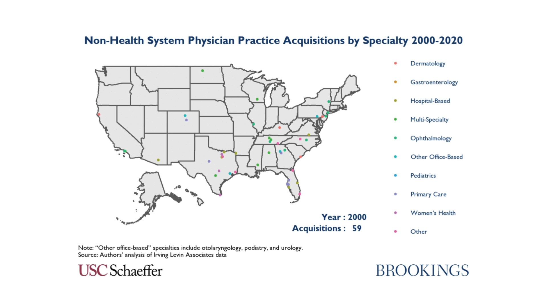
KMK
Star Alliance
The Invisible Customer
How Private Equity-Owned Practices are Changing the Biopharma Industry
FEBRUARY 24, 2022
Notes:
Hi everyone! Thanks for joining us today for this webinar, “The Invisible Customer – How Private Equity Practices are Changing the Biopharma Industry”

Slide 3
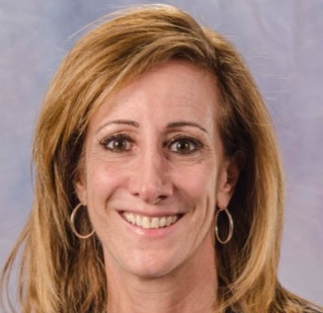
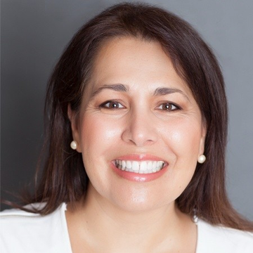

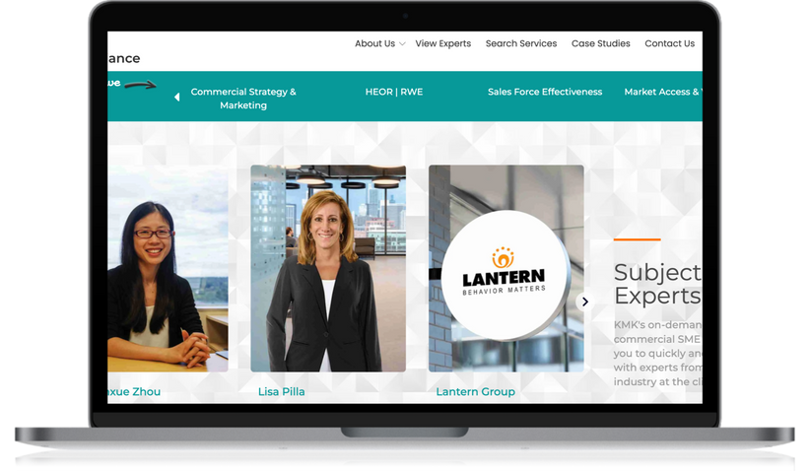
THE INVISIBLE CUSTOMER | FEBRUARY 24, 2022
KMK
Star Alliance
Lisa Pilla
Gina
Mastrosimone
Arielle Atwood
ON-DEMAND BIOPHARMA COMMERCIAL SME NETWORK
PRESIDENT, COACTION CONSULTING
INDEPENDENT BIOPHARMA CONSULTANT
ASSOCIATE DIRECTOR OF MARKETING
Industry leader in commercial strategy and sales and marketing effectiveness, her career spans over 30 years in Fortune 500, start-up and independent biopharma and life sciences companies.
Accomplished biopharma Strategy and Marketing consultant with over 25 years of industry and advisory experience working for and with Fortune 500 companies.
Head of all marketing activities at KMK Consulting and network manager for KMK Star Alliance SME Network - your host for today!
04

Slide 4
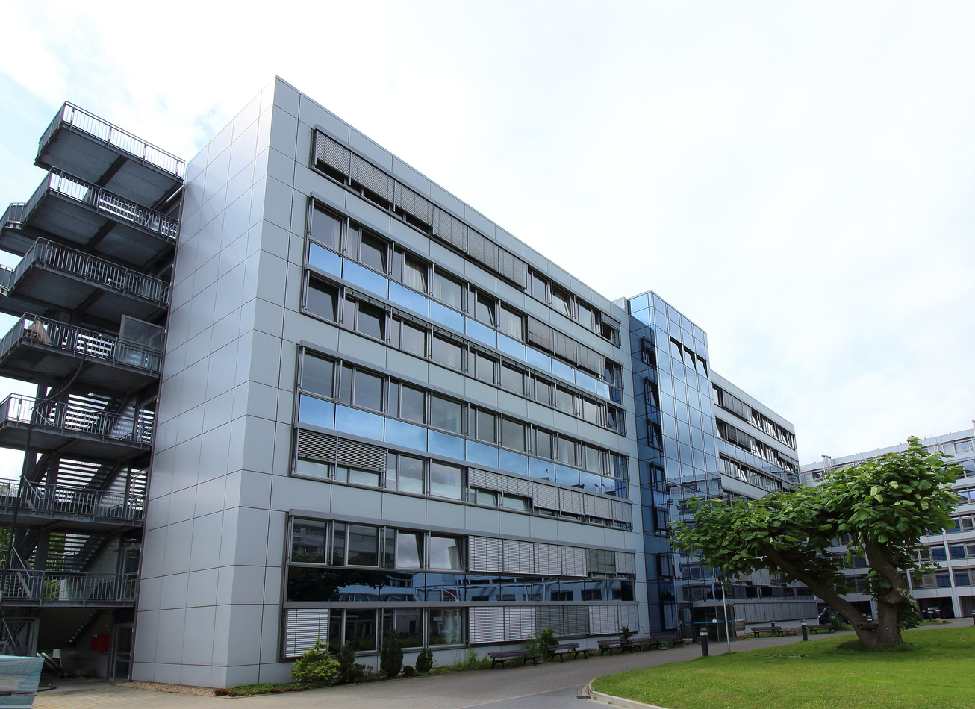
KMK
Star Alliance
THE INVISIBLE CUSTOMER | FEBRUARY 24, 2022
POLL:
Approximately what % of hospitals are owned by Private Equity Companies?
A. < 20%
B. 25 - 30%
C. 30 - 40%
D. > 50%
05
Notes:
Private equity firms now own about 25% of hospitals in the United States — and this figure will likely continue to grow.
Between 2003 and 2017, there were 42 private equity deals to purchase hospitals or hospital systems. These affected 282 hospitals in 36 states
Private equity investments in healthcare from $23.1 billion in 2015 to $78.9 billion in 2019
This is thought to be under-reported and recent estimates of PE investors funds allocated for health care are as high as $1.8 trillion (source: americanhealthlaw.org, , Soutar, Patrick D and Meyercord, Andrew N, “PE Investment in Private Practice: Has Its Time Finally Come or Will the Mistakes of the Past be Repeated?”, June 1, 2020

Slide 5





KMK
Star Alliance
THE INVISIBLE CUSTOMER | FEBRUARY 24, 2022
Improving the quality of care in a more efficient and economical manner
Macro Trends Driving the Consolidation of Healthcare Delivery
Care coordination and population health management
Increased reporting and regulatory requirements
HCPs desire to increase negotiating power
10
Notes:
Overall there’s a consolidation of HC delivery in US; explain trends; HCPs desire to increase negotiating power

Slide 6





KMK
Star Alliance
THE INVISIBLE CUSTOMER | FEBRUARY 24, 2022
As the owner and investor, Private Equity is an “Invisible Customer”:
PRACTICE MANAGEMENT COMPANY
PRIVATE EQUITY COMPANY
PHYSICIAN PRACTICE
Owns & funds the practice management company
Provides management services to practices
Delivers
healthcare
07
Notes:
HC delivery vs. practice mgmt.
Business focus vs. clinical focus
Regulations about Stark’s law
Operational efficiencies, revenue generation, influence of PM company on service mix & practice focus
Services are all consolidated and managed by practice mgmt. company who hires & manages HC providers

Slide 7

KMK
Star Alliance
THE INVISIBLE CUSTOMER | FEBRUARY 24, 2022
POLL:
According to AMA Physician Practice Benchmark Survey in 2018, which is greater:
A. The % of physicians who are employed
B. The % of physicians who own their own practices
08
Notes:
Growth in physicians who are employees as opposed to practice owners
Data from the AMA’sPhysician Practice Benchmark Survey
2016 was the first year in which less than half of practicing physicians (47.1 percent) had an ownership stake in their practice
2018 data marked the first year in which there were fewer physician owners (45.9 percent) than employees (47.4 percent).
practice ownership is shifting away from physician-owned practice (“private practice”) and toward working directly for a hospital or for a hospital-owned practice, and to an increasing extent PE owned PMOs.

Slide 8
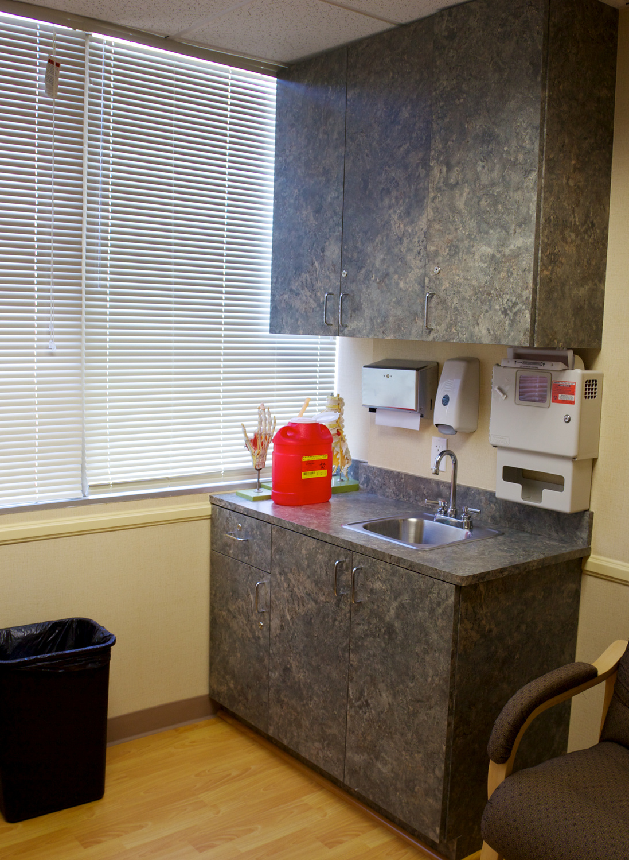
KMK
Star Alliance
THE INVISIBLE CUSTOMER | FEBRUARY 24, 2022
Employed Physicians now
exceed Practice Owners
THE DRIVE TO SELL
Increasing need for capital by physician practices and hospitals to meet demands of evolving US healthcare deliver model
Need to address business issues in addition to providing health care
2018 marked the first year in which there were fewer physician owners (45.9%) than employees (47.4%).
PRACTICE OWNER OPTIONS
  Reduced share of ownership in a bigger pie
  Tradeoff a degree of autonomy
  Give up ownership
  Tradeoff autonomy for practice resources
09
https://www.ama-assn.org/system/files/2019-07/prp-fewer-owners-benchmark-survey-2018.pdf
Notes:
Increasing need for capital by physician practices and hospitals to meet demands of evolving US healthcare deliver model
Increased operating costs
Declining reimbursement
Investment in expanded service lines to grow and diversify revenue streams
Competition with health systems
Need to address business issues in addition to providing health care
Revenue cycle management – managing cash flow
Payer negotiation
Data integration and management
Compliance
Sell to PE
Reduced share of ownership in a bigger pie
Tradeoff a degree of autonomy
Access to capital and business resources
Partner with PE to increase practice value as part of exit strategy
Work for health system
Give up ownership
Tradeoff autonomy for practice resources
Preferred provider contracts with payers
Access to capital
Reduced administrative and operating burden

Slide 9




KMK
Star Alliance
THE INVISIBLE CUSTOMER | FEBRUARY 24, 2022
Interest in Healthcare Sector is Driven by:
1
Growth is faster than GDP
2
Specialties remain fragmented & many HCPs are not professionally managed
3
Ability to create value by increasing efficiencies & consolidating market power
4
Recession-proof
10

Slide 10
KMK
Star Alliance
THE INVISIBLE CUSTOMER | FEBRUARY 24, 2022
12
https://www.brookings.edu/essay/private-equity-investment-as-a-divining-rod-for-market-failure-policy-responses-to-harmful-physician-practice-acquisitions/
Notes:
IDENTIFY GEOGRAPHY & PLATFORM PRACTICE
Local brand strength
Scope of services
Strategic fit of HCP
Financials
Capacity and productivity potential
Assets

Slide 11
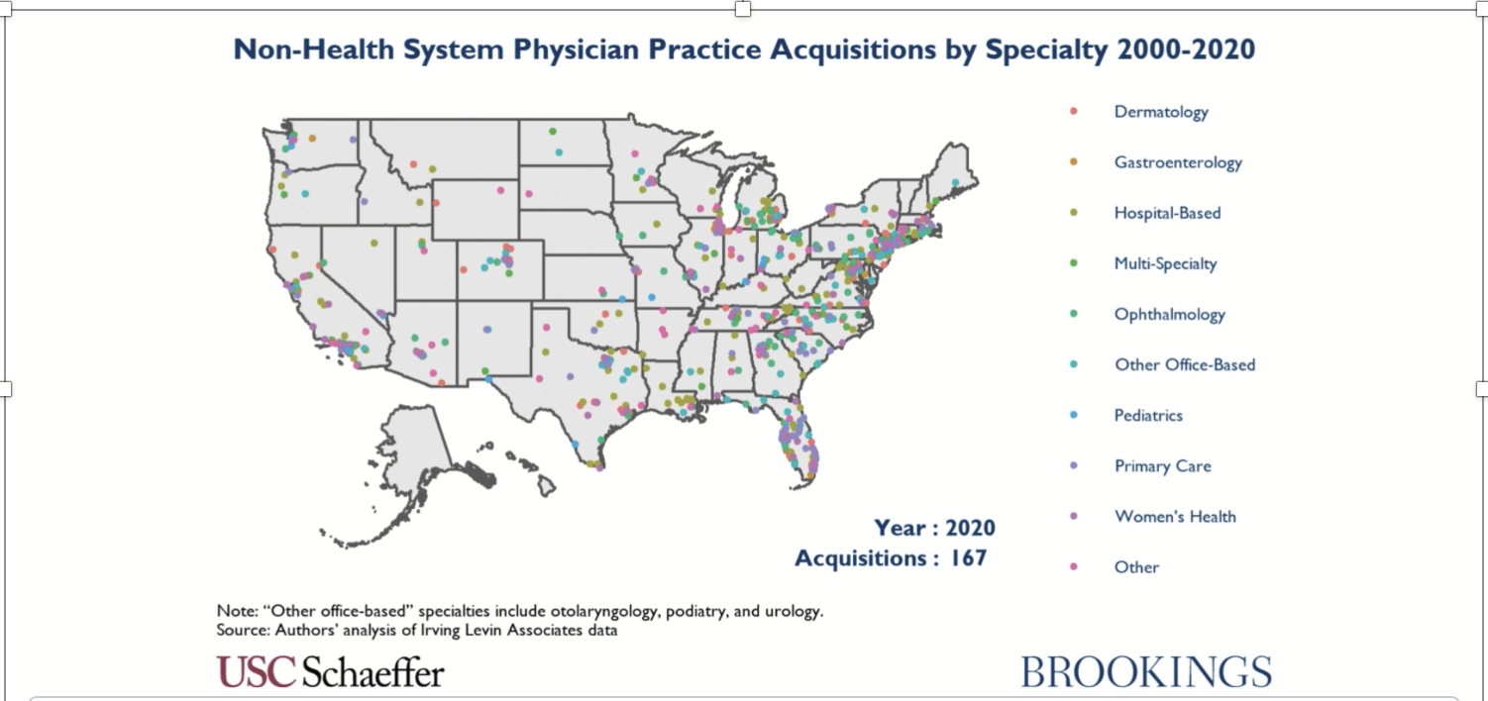
KMK
Star Alliance
THE INVISIBLE CUSTOMER | FEBRUARY 24, 2022
12
https://www.brookings.edu/essay/private-equity-investment-as-a-divining-rod-for-market-failure-policy-responses-to-harmful-physician-practice-acquisitions/

Slide 12



KMK
Star Alliance
THE INVISIBLE CUSTOMER | FEBRUARY 24, 2022
The PE Operating Model is Designed to Increase EBIDTA to Increase Valuation for Recapitalization
PRIVATE EQUITY COMPANY
PHYSICIAN PRACTICE
ASSET PURCHASE
Owns & funds the practice management company
PRACTICE MANAGEMENT COMPANY
Expand through HCP hiring
Provides management services to practices
EMPLOYS
NON-MEDICAL
STAFF
MERGER
NEW PHYSICIAN
PRACTICE
13
https://www.americanhealthlaw.org/content-library/journal-health-law/article/5a4d6c17-f1cb-4c1f-b233-24a6688ac674/private-equity-investment-in-the-physician-practic

Slide 13




KMK
Star Alliance
THE INVISIBLE CUSTOMER | FEBRUARY 24, 2022
Segmentation of PE-Owned Practices & PMOs Can Help Prioritize Engagement Options
high
OPERATIONAL FOCUS
Consolidation
CLINICAL & ECONOMIC FOCUS
Geographic Domination
2
1
Centralized Control
SPECIALTY FOCUS
Deep Penetration
GROWTH FOCUS
Care coordination and expansion of services
low
4
3
14
low
13
Scope of Services
high

Slide 14
KMK
Star Alliance
THE INVISIBLE CUSTOMER | FEBRUARY 24, 2022
Segmentation of PE-Owned Practices & PMOs Can Help Prioritize Engagement Options
high
2
OPERATIONAL FOCUS - Consolidation
1
CLINICAL & ECONOMIC FOCUS - Geographic Domination
  Partnerships in data mining, data integration, measurement
  Outcomes models
  Patient education and counseling resources
  Contracting
  Contracting
  Patient engagement tools
  Educational resources
  Clinical studies
Centralized Control
4
SPECIALTY FOCUS - Deep Penetration
3
GROWTH FOCUS - Care coordination and expansion of services
low
  Clinical studies
  Educational resources
  MSL/clinical educator support
  Partnerships in data mining
  HE/OR resources
  MSL/clinical educator support
  Patient engagement tools
  Educational resources
  Clinical studies
  Pop health resources
15
low
13
Scope of Services
high

Slide 15

KMK
Star Alliance
THE INVISIBLE CUSTOMER | FEBRUARY 24, 2022
Strategic
Implications
  Better understand the needs of a new customer segment
  Discover areas of potential collaboration
  Develop strategic approach to optimally engage Private Equity-owned practices
16
Notes:
GINA

Slide 16

KMK
Star Alliance
THE INVISIBLE CUSTOMER | FEBRUARY 24, 2022
Q & A
18

